Slide 1
COMP 336 Search Engines for Web and Enterprise Data
Instructor: Prof. Dik Lun Lee
COMP 336 Dik Lun LEE Department of Computer Science and Engineering, HKUST Slide <number>

Slide 2
Search Engines are not New!
It has many names:
Information retrieval (IR)
Document retrieval
Text retrieval
and applications:
Digital libraries
Web search
COMP 336 Dik Lun LEE Department of Computer Science and Engineering, HKUST Slide <number>

Slide 3
What Kind of Data does Information Retrieval Deal With?
Unformatted or unstructured data (as opposed to relational database)
  Textual data: papers, technical reports, newspaper articles
  Completed untagged, plain-text data
Semi-structured data
  Web pages (HTML and XML files)
  Email messages
Non-textual data
  images, graphics, video
COMP 336 Dik Lun LEE Department of Computer Science and Engineering, HKUST Slide <number>

Slide 4
Examples of IR Systems :
Most people used IR systems one way or the other!
COMP 336 Dik Lun LEE Department of Computer Science and Engineering, HKUST Slide <number>
Notes:
To search for “information retrieval”, you must start with the first character, I.e., you can search ‘i’, ‘info’, ‘information’, etc., but you cannot just search ‘retrieval’. Easy to implement, because the system only needs to maintain a list of sorted course titles.
Answerbook: searches keywords withink title (and perhaps abstract too), but no full-text search
Search sophication, search scope, etc., affect the cost of implementation

Slide 5
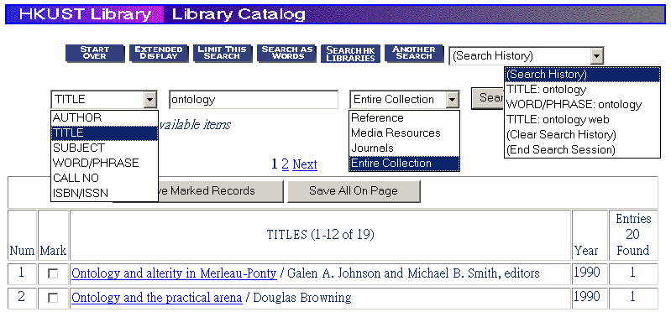
Library systems
    Books: http://ustlib.ust.hk/ (HKUST library)
Federated search
COMP 336 Dik Lun LEE Department of Computer Science and Engineering, HKUST Slide <number>
Notes:
To search for “information retrieval”, you must start with the first character, I.e., you can search ‘i’, ‘info’, ‘information’, etc., but you cannot just search ‘retrieval’. Easy to implement, because the system only needs to maintain a list of sorted course titles.
Answerbook: searches keywords withink title (and perhaps abstract too), but no full-text search
Search sophication, search scope, etc., affect the cost of implementation

Slide 6
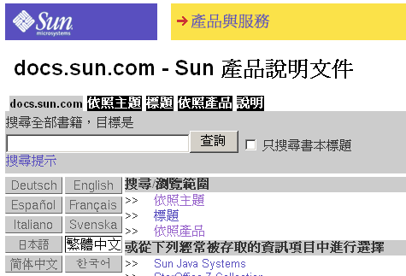
Product Websites: Sun Microsystems
Electronic manual systems such as Sun Microsystem’s AnswerBook (http://docs.sun.com)
    input data: various set of manuals
    query format: supports AND/OR (soften form), phrase, etc.
    presentation of results: results ranked and document types
Browse subject, title, etc.
COMP 336 Dik Lun LEE Department of Computer Science and Engineering, HKUST Slide <number>
Notes:
To search for “information retrieval”, you must start with the first character, I.e., you can search ‘i’, ‘info’, ‘information’, etc., but you cannot just search ‘retrieval’. Easy to implement, because the system only needs to maintain a list of sorted course titles.
Answerbook: searches keywords withink title (and perhaps abstract too), but no full-text search
Search sophication, search scope, etc., affect the cost of implementation

Slide 7

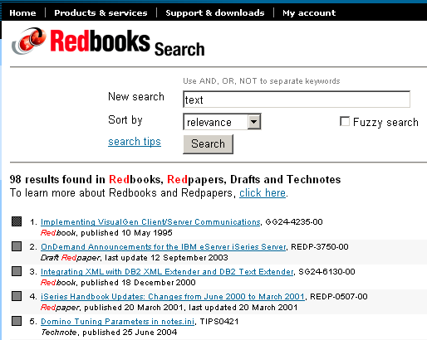
Product Websites: IBM Redbooks
IBM Red Books (http://www.redbooks.ibm.com/)
Use darkness to indicate relevance
COMP 336 Dik Lun LEE Department of Computer Science and Engineering, HKUST Slide <number>
Notes:
To search for “information retrieval”, you must start with the first character, I.e., you can search ‘i’, ‘info’, ‘information’, etc., but you cannot just search ‘retrieval’. Easy to implement, because the system only needs to maintain a list of sorted course titles.
Answerbook: searches keywords withink title (and perhaps abstract too), but no full-text search
Search sophication, search scope, etc., affect the cost of implementation

Slide 8
Embedded Search Engines (Search CDs)
Electronic encyclopaedia (online or CDROM), product catalogues, corporate annual reports, etc.
  Don’t forget that a CD could hold 600 Mbytes of text!
Does it require installation
Is it web-based
Is it fast (running on desktops)
COMP 336 Dik Lun LEE Department of Computer Science and Engineering, HKUST Slide <number>
Notes:
To search for “information retrieval”, you must start with the first character, I.e., you can search ‘i’, ‘info’, ‘information’, etc., but you cannot just search ‘retrieval’. Easy to implement, because the system only needs to maintain a list of sorted course titles.
Answerbook: searches keywords withink title (and perhaps abstract too), but no full-text search
Search sophication, search scope, etc., affect the cost of implementation

Slide 9
Desktop Search: Searching your Files
  UNIX ‘man –k’ and grep commands
$ grep comp336 input-file1 input-file2 …
Matched lines
From input file
Input files
grep
Query = comp336
Input file is defaulted
to UNIX man pages
COMP 336 Dik Lun LEE Department of Computer Science and Engineering, HKUST Slide <number>

Slide 10
How do you Search for Files on Windows?
Search for files: plain text, MS Office files, email, etc.
Specify filenames, dates, file types, etc.
Windows XP built-in function, Yahoo Desktop, Google Desktop, Windows Desktop, etc.
COMP 336 Dik Lun LEE Department of Computer Science and Engineering, HKUST Slide <number>

Slide 11
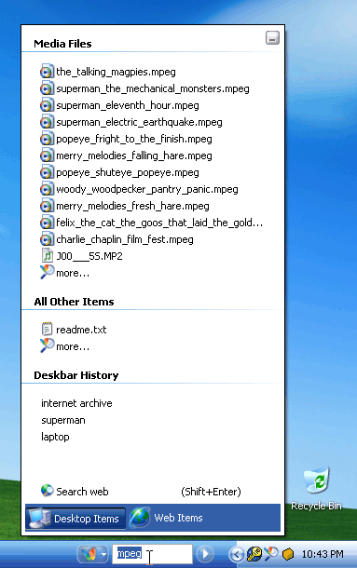
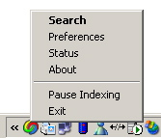
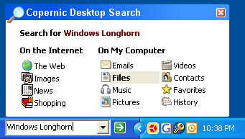
Desktop Search Examples
Search result
COMP 336 Dik Lun LEE Department of Computer Science and Engineering, HKUST Slide <number>

Slide 12
Web Search Engines
World wide web search engines: we will cover them a lot
  Most popular IR application nowadays, e.g., Google, Altavista, Yahoo!, MSN Search, etc.
Index
Search
engine
User
queries
spider
Web pages
COMP 336 Dik Lun LEE Department of Computer Science and Engineering, HKUST Slide <number>
Notes:
To search for “information retrieval”, you must start with the first character, I.e., you can search ‘i’, ‘info’, ‘information’, etc., but you cannot just search ‘retrieval’. Easy to implement, because the system only needs to maintain a list of sorted course titles.
Answerbook: searches keywords withink title (and perhaps abstract too), but no full-text search
Search sophication, search scope, etc., affect the cost of implementation

Slide 13
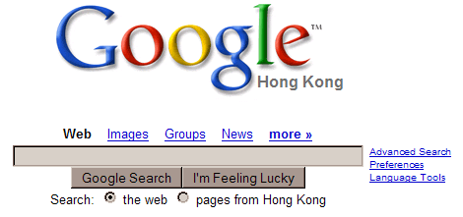


The Trio: Google, Yahoo! and MSN
COMP 336 Dik Lun LEE Department of Computer Science and Engineering, HKUST Slide <number>
Notes:
To search for “information retrieval”, you must start with the first character, I.e., you can search ‘i’, ‘info’, ‘information’, etc., but you cannot just search ‘retrieval’. Easy to implement, because the system only needs to maintain a list of sorted course titles.
Answerbook: searches keywords withink title (and perhaps abstract too), but no full-text search
Search sophication, search scope, etc., affect the cost of implementation

Slide 14
Differences between Search on Web and Relational Data?
 | Product / library search | Public web search
COMP 336 Dik Lun LEE Department of Computer Science and Engineering, HKUST Slide <number>
Notes:
To search for “information retrieval”, you must start with the first character, I.e., you can search ‘i’, ‘info’, ‘information’, etc., but you cannot just search ‘retrieval’. Easy to implement, because the system only needs to maintain a list of sorted course titles.
Answerbook: searches keywords withink title (and perhaps abstract too), but no full-text search
Search sophication, search scope, etc., affect the cost of implementation

Slide 15
Why is IR Important?
Most information available is in textual form and has no predefined format (e.g., emails and newsgroup articles)
Integration of text retrieval capability in most relational database systems. SQL already supports limited search capability such as search based on regular expressions:
  select * from Employee where Name like ’%Lee%’
Increasing number of online documentation systems
(no more hardcopy!)
Of course, the blooming of World Wide Web
COMP 336 Dik Lun LEE Department of Computer Science and Engineering, HKUST Slide <number>

Slide 16
Why is IR a Difficult Problem?
The size of the web is doubling every year:
  50 million pages in November 1995
  320 million pages in December 1997
  800 million pages in February 1999
  1 billion pages in 2000
  3.5 billion in 2003 (openfind.com)
  8 billion in 2004 (google.com)
  20+ billion in 2005 (yahoo.com)
    Google stopped releasing the size
Huge amount of data (e.g., WWW) dictates efficiency, effectiveness and user-friendliness
  A few hundred Mbytes was considered large a decade ago; today, a single database can easily grow to 10-50 Gbytes or more
Imagine you need to spend
“just one second more” on each page!
Renders Natural Language Processing
methods infeasible
COMP 336 Dik Lun LEE Department of Computer Science and Engineering, HKUST Slide <number>

Slide 17
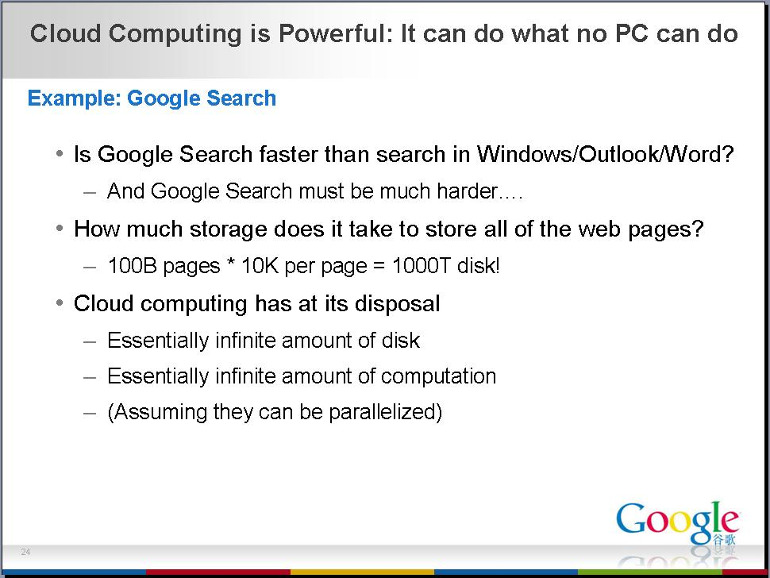
COMP 336 Dik Lun LEE Department of Computer Science and Engineering, HKUST Slide <number>

Slide 18
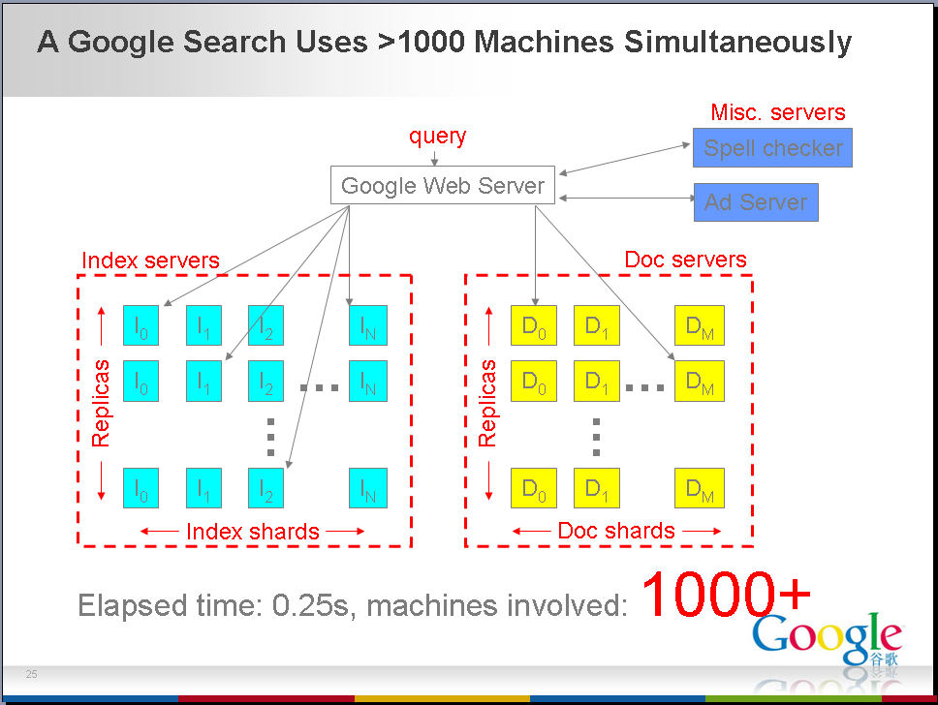
COMP 336 Dik Lun LEE Department of Computer Science and Engineering, HKUST Slide <number>

Slide 19
Why is IR a Difficult Problem? (Cont.)
Unstructured data: difficult to capture semantics in documents. Compare:
  “select * from Employee where Salary > 100,000”
  “retrieve all news items about corporate takeover”
Why is the second query more difficult to answer? The following query is even more difficult:
  “retrieve all news items about corporate takeover involving an internet company”
  Note: syntactic → semantic → real-world knowledge
Documents have unrestricted domains
  it is hard to predefine or pre-categorize the subject domains of documents
COMP 336 Dik Lun LEE Department of Computer Science and Engineering, HKUST Slide <number>

Slide 20
Why is IR a Difficult Problem? (Cont.)
Diversified user base: expert to casual users
  a system may be clumsy for an expert user but difficult to use for a casual user
  a system may return information too general to be useful for an expert in the subject but too narrow for a general user
Intention of information and user query is hard to capture
  compare a README file and a user manual
  compare a summary versus an in-depth report
One size cannot fit all!
COMP 336 Dik Lun LEE Department of Computer Science and Engineering, HKUST Slide <number>

Slide 21
Doing it by People (Librarians)
High labor cost of trained human indexers
Inconsistency in selecting index terms and judging relevance
  thesauri created by two indexers in a given subject domain have only 60% of index terms in common
  indexes obtained by two indexers from the same document with the same thesaurus have only 30% in common
  documents obtained from two persons searching the same document set with the same question have only 40% in common
  relevance judgments obtained by two users on the same set of documents and the same topic have only 60% in common
COMP 336 Dik Lun LEE Department of Computer Science and Engineering, HKUST Slide <number>

Slide 22
Why is IR a Difficult Problem?
Distributed and interlinked (e.g., Hypertext and WWW)
  Where to start a search? Unlike in a centralize database, you have only one (or a few) database(s) to search.
  How are the information related?
How fast
How good
Efficiency vs. effectiveness
  With a limited amount of resources, one can only improve efficiency and effectiveness to a certain degree. Moreover, improving efficiency often means degrading effectiveness, and vice versa.
COMP 336 Dik Lun LEE Department of Computer Science and Engineering, HKUST Slide <number>

Slide 23
Document Retrieval Model
Relevance Feedback
User’s information need
Query formulation
Retrieved
documents
Document modification
Documents
Formal language
retrieval
Document representation
Indexing
Document: a long string of characters contained in a single file
Index: a list of important keywords from the documents, stored in some efficient file structure
Query: Boolean (A and B or C), list of words, natural language
Relevance feedback: try “similar pages” in Google
COMP 336 Dik Lun LEE Department of Computer Science and Engineering, HKUST Slide <number>

Slide 24
Evolution of Search Technologies
Zeroth-generation search (1960 -)
  Libraries, collections of electronic documents (legal documents, Lexis/Nexis, scientific databases)
  Individual documents organized in folders or databases
  Keyword-based search (looking for keywords)
  Search on fields (title, author, date) in addition to search on full text body
  Boolean (title=“computer” AND body contains “IBM”)
  E.g., IBM Stairs
  0.5 generation: adding statistical to Boolean (e.g., how often does a keyword appear in a document and where?)
COMP 336 Dik Lun LEE Department of Computer Science and Engineering, HKUST Slide <number>

Slide 25
Evolution of Search Technologies (Cont.)
First-generation search engines (web-based, 1993 -)
  Statistical keyword match
    traditional search methods applied to web
  Add a spider / crawler
  Earlier versions of Altavista, Infoseek, Lycos, etc.
Second-generation search engines (1997 - )
  In addition to keyword matching, relying heavily on link analysis (thus capitalizing the special property of web)
  Google, Fast, etc. etc.
COMP 336 Dik Lun LEE Department of Computer Science and Engineering, HKUST Slide <number>

Slide 26
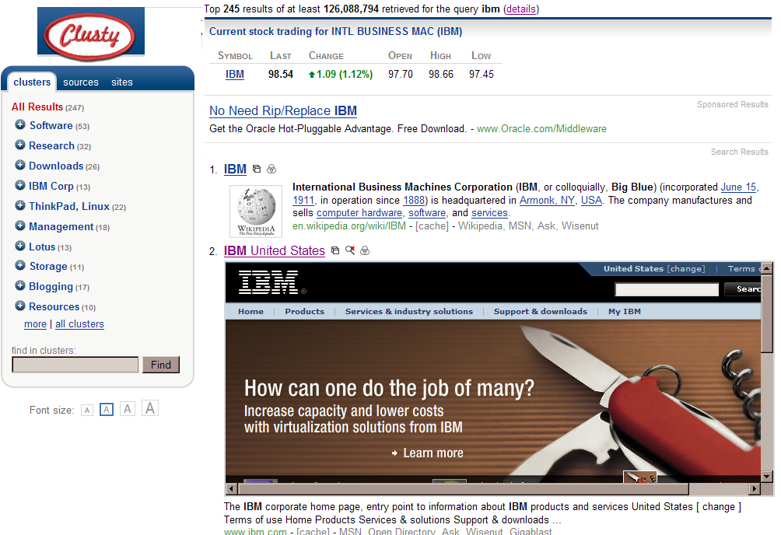
Evolution of Search Technologies (Cont.)
Third-generation search engines (2001- )
  Incorporate advanced search features, e.g., automatic categorization
Challengers:
Teoma (acquired by ask.com)
Wisenut (acquired by Looksmart)
Vivisimo (owning clusty.com)
Powerset (acquired by Microsoft July 1, 2008 at allegedly US$ 100m)
Companies that you will start!
COMP 336 Dik Lun LEE Department of Computer Science and Engineering, HKUST Slide <number>

Slide 27
COMP 336 Dik Lun LEE Department of Computer Science and Engineering, HKUST Slide <number>

Slide 28
COMP 336 Dik Lun LEE Department of Computer Science and Engineering, HKUST Slide <number>

Slide 29
Key Challenges to Search Engines
Users
Data
System
COMP 336 Dik Lun LEE Department of Computer Science and Engineering, HKUST Slide <number>
Notes:
To search for “information retrieval”, you must start with the first character, I.e., you can search ‘i’, ‘info’, ‘information’, etc., but you cannot just search ‘retrieval’. Easy to implement, because the system only needs to maintain a list of sorted course titles.
Answerbook: searches keywords withink title (and perhaps abstract too), but no full-text search
Search sophication, search scope, etc., affect the cost of implementation

Slide 30
Impacts of Search Engines on Us
By July 2008, more than 1 trillion unique URLs were indexes by Google, having grown by 44% annually during the preceding 10 years (Ref: Official Google Blog July 26, 2008)
In 2010, 1.6 trillion searches were conducted globally; an average internet user in US performed ~1500 searches (comCore)
~90% of online users use search engines – that means 1.7 billion people (comCore)
10% of the time we spent on the web is spent on search – that is about 4 hours/month; knowledge workers in enterprises spent about 5 hours/week or 12% of their time on search (McKinsey)
25% of traffic to mainstream websites is referred by search engines (McKinsey); non-mainstream depends on search engine even more
COMP 336 Dik Lun LEE Department of Computer Science and Engineering, HKUST Slide <number>
Notes:
To search for “information retrieval”, you must start with the first character, I.e., you can search ‘i’, ‘info’, ‘information’, etc., but you cannot just search ‘retrieval’. Easy to implement, because the system only needs to maintain a list of sorted course titles.
Answerbook: searches keywords withink title (and perhaps abstract too), but no full-text search
Search sophication, search scope, etc., affect the cost of implementation

Slide 31
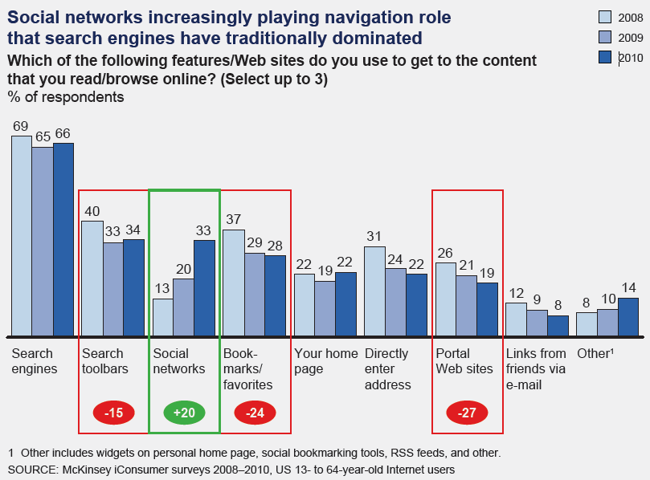
Channels we use to Access Information?
COMP 336 Dik Lun LEE Department of Computer Science and Engineering, HKUST Slide <number>
Notes:
To search for “information retrieval”, you must start with the first character, I.e., you can search ‘i’, ‘info’, ‘information’, etc., but you cannot just search ‘retrieval’. Easy to implement, because the system only needs to maintain a list of sorted course titles.
Answerbook: searches keywords withink title (and perhaps abstract too), but no full-text search
Search sophication, search scope, etc., affect the cost of implementation

Slide 32
The Search Industry (and our Job Market)
Enterprise search
  Companies use their own search engines to enhance the productivity of knowledge workers; vendors include Endeca (Oracle), Autonomy (HP), Microsoft, and Google; global market estimated at US$2.8b in 2010
Classified and local search
  Yellow/White page directories, recruitment and travel web sties; ad placement is the largest source of revenue; global market estimated to worth US$8b in 2010
Search marketing
  Search engine providers (Bing, Yahoo, Google) earning ad revenue; companies offering search engine optimization (SEO) services; global market estimated at US$30b in 2010
COMP 336 Dik Lun LEE Department of Computer Science and Engineering, HKUST Slide <number>
Notes:
To search for “information retrieval”, you must start with the first character, I.e., you can search ‘i’, ‘info’, ‘information’, etc., but you cannot just search ‘retrieval’. Easy to implement, because the system only needs to maintain a list of sorted course titles.
Answerbook: searches keywords withink title (and perhaps abstract too), but no full-text search
Search sophication, search scope, etc., affect the cost of implementation

